Slide 1
Lesson 10 Two Sample F-test Concepts E214 – Statistical Methods for Engineering

Slide 2
E214 – Statistical Methods for Engineering
Inferential Statistics
Hypothesis Testing
Parameter Estimation
Organize & summarize data collected
Probability and Distributions
Venn Diagram
Discrete Random Variables and Probability Distributions
Probability Distributions
Descriptive Statistics
Continuous Random Variables and Probability Distributions
Binomial Distribution
Poisson Distribution
Normal Distribution
Exponential Distribution
Tree Diagram
A more detailed topic tree on Hypothesis Testing will be given from P08 onwards

Slide 3
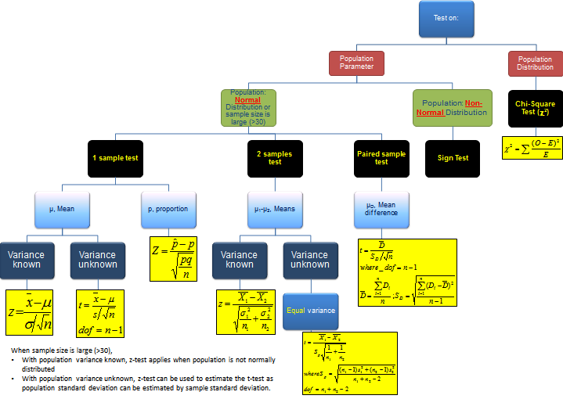
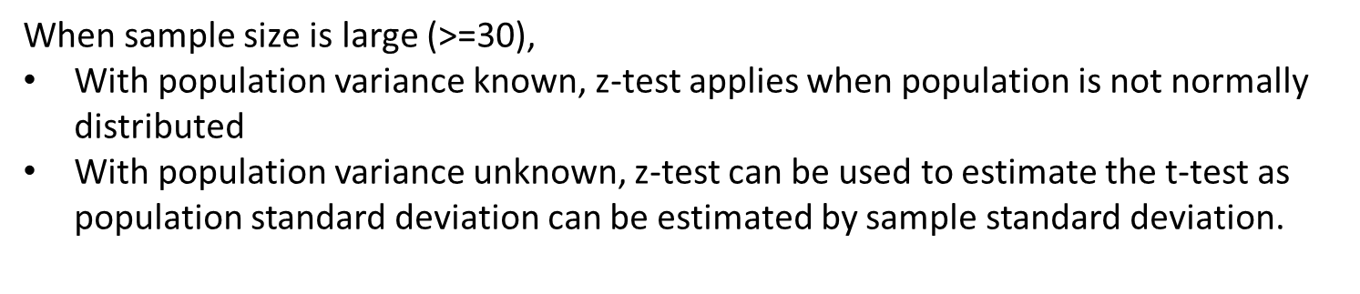
Topic Tree for Hypothesis Testing
ANOVA
A tool to compare the means of several (3 or more) populations with a single test.
2 samples test on variance
σ₁² – σ₂²
F = $\frac{S12}{S22}$
with n₁-1 numerator dof and n₂-1 denominator dof, where n₁ and n₂ are sample sizes
L10

Slide 4
Overview of Hypothesis Testing Procedure
From problem, identify the population parameter of interest.
State clearly the null hypothesis H₀ and alternative hypothesis H₁.
State clearly the level of significance of the test (if not given in problem, we can assume typical value of 1%, 2% or 5%).
State the test statistic to be used, together with any necessary assumptions made.
Compute the value of the test statistic using the given sample data.
6. i) If using the critical region method: based on the stated level of significance , determine the critical value(s) and state the critical region.
ii) If using p-value method: based on the calculated value of test statistic, calculate the p-value.
7. Make a decision whether to reject H₀:
i) If using critical region method: Reject H₀ if calculated test statistic falls inside the critical region. Otherwise, do not reject H_{0.}
ii) If using p-value approach: Reject H₀ if p-value < level of significance. Otherwise, do not reject H_{0.}
8. Write down a formal conclusion in the problem context.

Slide 5
Flowchart for Comparing Means of Two Independent Populations
Use F-test to see if variances of the 2 populations are significantly different or not
Variances are significantly different
Variances are not significantly different
Use the two-sample t –test with unequal variances
Use the two-sample t-test with equal variances (two-sample pooled t test)

Slide 6
Two-sample F-Test on Population Variances: Formulation of Null and Alternative Hypotheses
For two-sample hypothesis tests comparing the variances of two independent populations, the various formulations of null and alternative hypotheses are shown below:
Let $σ_{X}^{2},σ_{Y}^{2}$ denote the population variances of distributions $X$ and $Y$ respectively.
$H_{0}:$ $σ_{X}^{2}=σ_{Y}^{2}$
${ H}_{1}:$ $σ_{X}^{2}<σ_{Y}^{2}$ (Lower-tailed, or left-tailed test)
$H_{0}: σ_{X}^{2}=σ_{Y}^{2}$
$H_{1}:σ_{X}^{2}≠σ_{Y}^{2}$ (Two-tailed test)
$H_{0}:σ_{X}^{2}=σ_{Y}^{2}$
${ H}_{1}:σ_{X}^{2}>σ_{Y}^{2}$ (Upper-tailed, or right-tailed test)

Slide 7
F-test to Compare Population Variances
Used to determine if variances are significantly different, usually before conducting a t-test to compare the means of two sets of data
Also used as a simple general test to compare the precision (as measured by the variances or standard deviations) of two sets of data
The F test statistic follows the F distribution
Assumptions needed for the F-test:
Both populations are normally distributed
The two population distributions are independent.
Notes:
To elaborate on the first point from slide 22 onwards (easier for students to understand with examples and application)

Slide 8
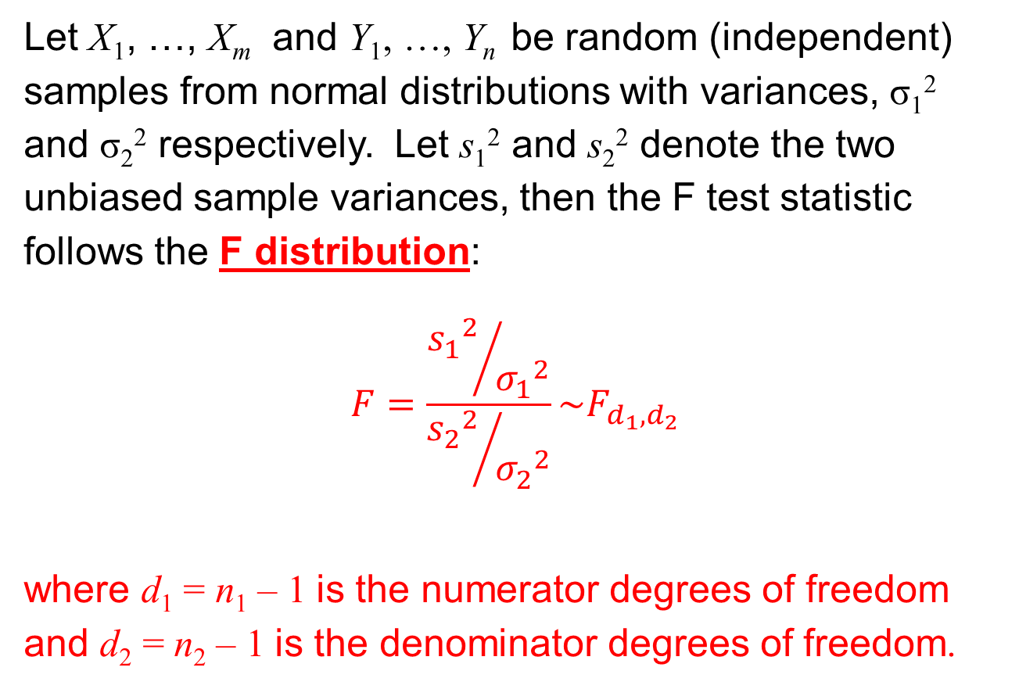
The F Test Statistic
Let X₁, …, X_{m} and Y₁, …, Y_{n} be random (independent) samples from normal distributions with variances, σ₁² and σ₂² respectively. Let s₁² and s₂² denote the two unbiased sample variances, then the F test statistic follows the F distribution:
$$F=\frac{{{s_{1}}^{2}}/{{σ_{1}}^{2}}}{{{s_{2}}^{2}}/{{σ_{2}}^{2}}}\sim F_{d_{1},d_{2}}$$
where d₁ = n₁ – 1 is the numerator degrees of freedom and d₂ = n₂ – 1 is the denominator degrees of freedom.

Slide 9
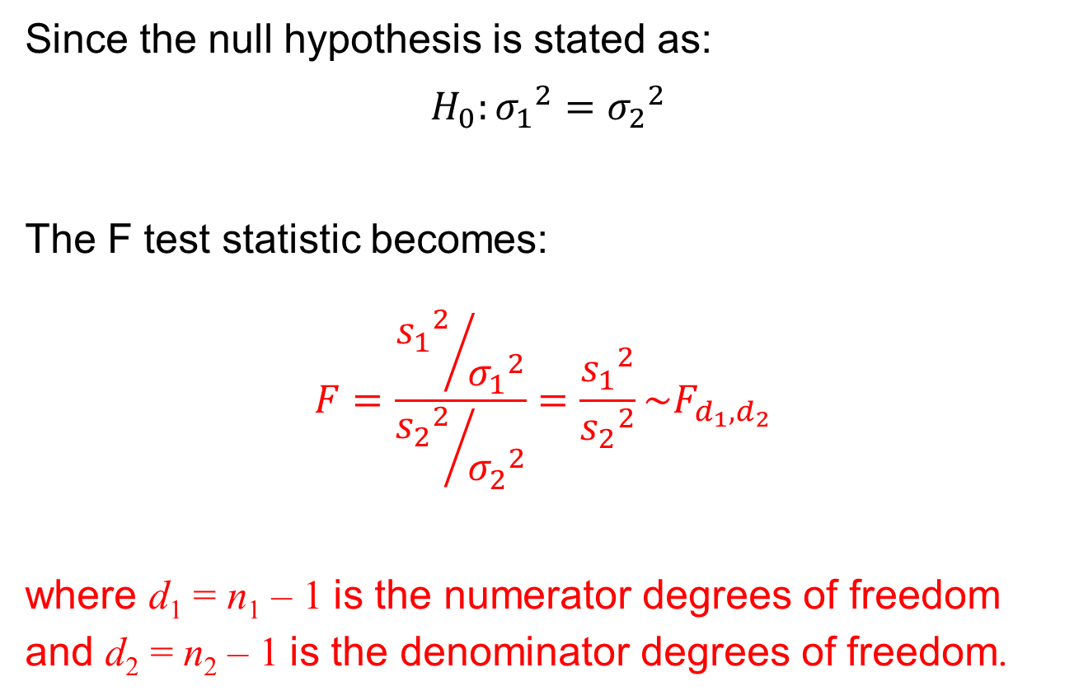
The F Test Statistic
Since the null hypothesis is stated as:
$H_{0}:{σ_{1}}^{2}={σ_{2}}^{2}$
The F test statistic becomes:
$$F=\frac{{{s_{1}}^{2}}/{{σ_{1}}^{2}}}{{{s_{2}}^{2}}/{{σ_{2}}^{2}}}=\frac{{s_{1}}^{2}}{{s_{2}}^{2}}\sim F_{d_{1},d_{2}}$$
where d₁ = n₁ – 1 is the numerator degrees of freedom and d₂ = n₂ – 1 is the denominator degrees of freedom.

Slide 10
Characteristics of the F Distribution
Each member of the family is determined by two parameters: the numerator degrees of freedom and the denominator degrees of freedom.
The F statistic cannot be negative, and the F distribution is continuous.
Its value ranges from 0 to ∞ . As F → ∞, the curve approaches the x-axis.
The F distribution is positively (right) skewed.
Excel functions:
F.DIST(x, d₁, d₂,1) (returns left-tail probability of x)
F.DIST.RT(x, d₁, d₂) (returns right-tail probability of x)
F.INV(probability, d₁, d₂) (returns left-tail F value corresponding to ‘probability’).
F.INV.RT(probability, d₁, d₂) (returns right-tail F value corresponding to ‘probability’)
d₁: numerator degrees of freedom; d₂: denominator degrees of freedom
9

Slide 11
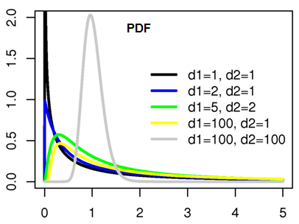
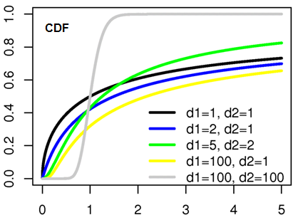
PDF, CDF Graphs of F distribution

Slide 12
Application of the F distribution
The F distribution is used in many statistical tests
Test for equality of variances.
Tests for differences in means in ANOVA.
Tests for regression models (slopes relating one continuous variable to another like SAT and GPA).

Slide 13











Two-sample F-test on Population Variances: Determination of Critical Value(s) and Critical Region
$${ H}_{0}:σ_{1}^{2}=σ_{2}^{2}$$
$${ H}_{1}:σ_{1}^{2}<σ_{2}^{2}$$
$H_{0}:σ_{1}^{2}=σ_{2}^{2}$
$${ H}_{1}:σ_{1}^{2}≠σ_{2}^{2}$$
$$H_{0}:σ_{1}^{2}=σ_{2}^{2}$$
$${ H}_{1}:σ_{1}^{2}>σ_{2}^{2}$$
(Lower-tailed test)
(Two-tailed test)
(Upper-tailed test)
$$α$$
$$\frac{α}{2}$$
$${F\sim F}_{n_{1}−1,n_{2}−1}$$
$$F\sim F_{n_{1}−1,n_{2}−1}$$
$$F\sim F_{n_{1}−1,n_{2}−1}$$
$$\frac{α}{2}$$
$$α$$
0
$$L$$
0
$$L$$
$$U$$
0
$$U$$
Critical value, $L$
$$=F.INV\left(α,n_{1}−1,n_{2}−1\right)$$
Critical region
$$=\left\{f:0<f<L\right\}$$
Lower critical value, $L$
$=F.INV(\frac{α}{2},n_{1}−1,n_{2}−1$)
Upper critical value, $U$
$$=F.INV.RT(\frac{α}{2},n_{1}−1,n_{2}−1)$$
Critical region
$$=\left\{f:0<f<L or f>U\right\}$$
Critical value, $U$
$$=F.INV\left(1−α,n_{1}−1,n_{2}−1\right)$$
Or
F.INV.RT($α$,$n_{1}−1,n_{2}−1$)
Critical region
$$=\left\{f: f>U\right\}$$
Note:
Numerator degrees of freedom = $n_{1}−1$
Denominator degrees of freedom = $n_{2}−1$
13

Slide 14





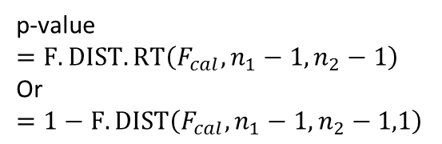
Two-sample F-test on Population Variances: Determination of P-value
$${ H}_{0}:σ_{1}^{2}=σ_{2}^{2}$$
$${ H}_{1}:σ_{1}^{2}<σ_{2}^{2}$$
$H_{0}:σ_{1}^{2}=σ_{2}^{2}$
$${ H}_{1}:σ_{1}^{2}≠σ_{2}^{2}$$
$$H_{0}:σ_{1}^{2}=σ_{2}^{2}$$
$${ H}_{1}:σ_{1}^{2}>σ_{2}^{2}$$
(Lower-tailed test)
(Two-tailed test)
(Upper-tailed test)
p-value
If $F_{cal}>1:$
p-value
= 2*F.DIST.RT($F_{cal},n_{1}−1,n_{2}−1$)
Or
2*[ 1 – F.DIST($f_{cal},n_{1}−1,n_{2}−1$, $1$)
If $F_{cal}<1:$
p-value
=2*F.DIST($f_{cal},n_{1}−1,n_{2}−1$, $1$)
$${F\sim F}_{n_{1}−1,n_{2}−1}$$
$${F\sim F}_{n_{1}−1,n_{2}−1}$$
p-value
0
$$f_{cal}$$
0
$$f_{cal}$$
p-value
$$=F.DIST\left(F_{cal},n_{1}−1,n_{2}−1,1\right)$$
p-value
$$=F.DIST.RT\left(F_{cal},n_{1}−1,n_{2}−1\right)$$
Or
$$=1−F.DIST\left(F_{cal},n_{1}−1,n_{2}−1,1\right)$$
Note:
Numerator degrees of freedom = $n_{1}−1$
Denominator degrees of freedom = $n_{2}−1$
In practice, one would only require to apply either the critical region method or the p-value method in a statistical test, and not both.
14

Slide 15
Learning Objectives
Perform two-sample F-test to compare the variances of two independent populations
Apply the appropriate two-sample t-test based on the outcome of the two-sample F-test on population variances

Slide 16
E-Learning Video
You are strongly encouraged to watch the e-learning video prepared for P10 to enhance your understanding of the main learning objectives.
You can access the e-learning video from the following link:
https://drive.google.com/file/d/0B0VVo-P5cYtqVWZXNF9ZM3hpVGc/edit?usp=sharing

